Slide 1
Missing Values for PCR Overview
8th April 2024

Slide 2
Missing Values
# | Name | Frame | Section | Property Group | Property Name | Remark
1 | tyre weight calc.d | ?? | ??
2 | greentyre weight calc.d | ?? | ??
3 | vulcanized tyre | Cured Tyre: A_PCR_VULCv1 and E_PCR_VULC | Specification name / Part number
4 | pibs budget | ?? | ??
5 | rolling resistance | Finished Tyre: A_PCR | Labels and Certifications | Lables Rolling resistance | "EPREL EU Lable" x "Lable"
6 | tyre noise label | Finished Tyre: A_PCR | Labels and Certifications | Lable Noise | "EPREL EU Lable" x "Sound Lable"
7 | tyre noise | Finished Tyre: A_PCR | Labels and Certifications | Lable Noise | "EPREL EU Lable" x "Noise (dB)"
8 | wet grip index | Finished Tyre: A_PCR | Labels and Certifications | Lables Wet grip | "EPREL EU Lable" x "Lable" | Change the filed name to Wet Grip Lable
10 | curing critical point | Cured Tyre: A_PCR_VULCv1 and E_PCR_VULC | Processing Gyos and Processing Enschede | Remarks | curing critical point | Different Frames for the different plants

Slide 3
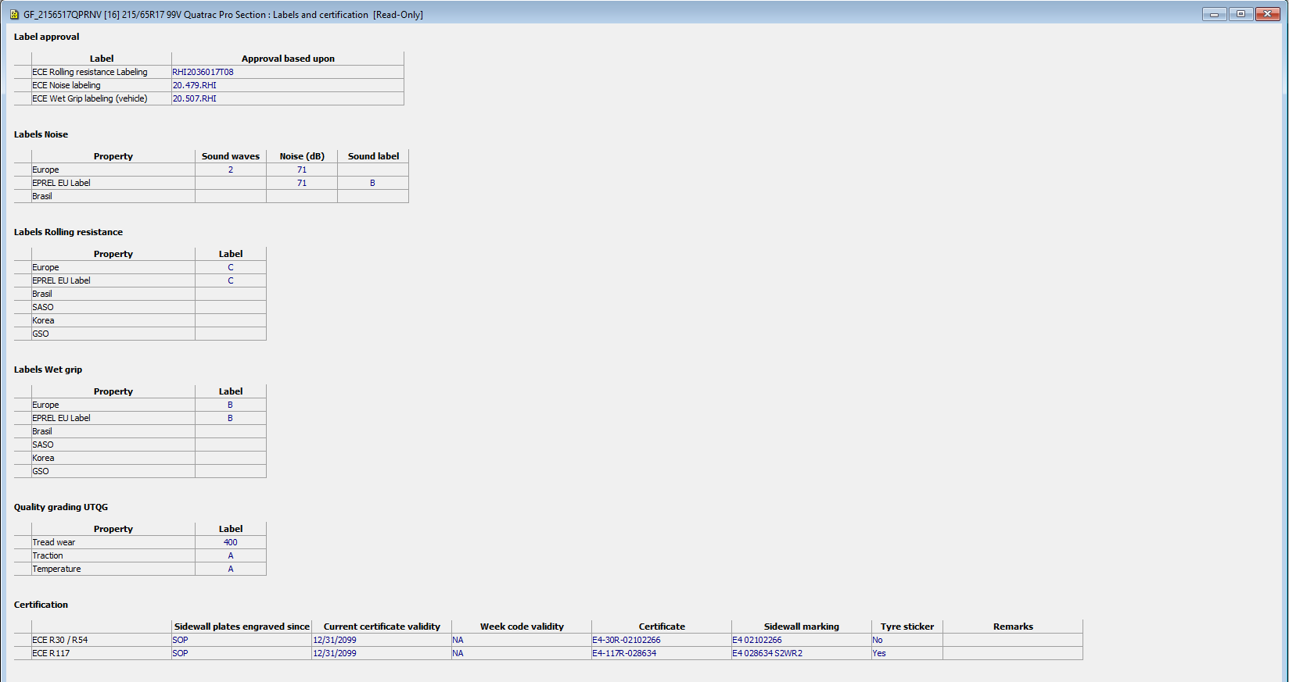

Slide 4
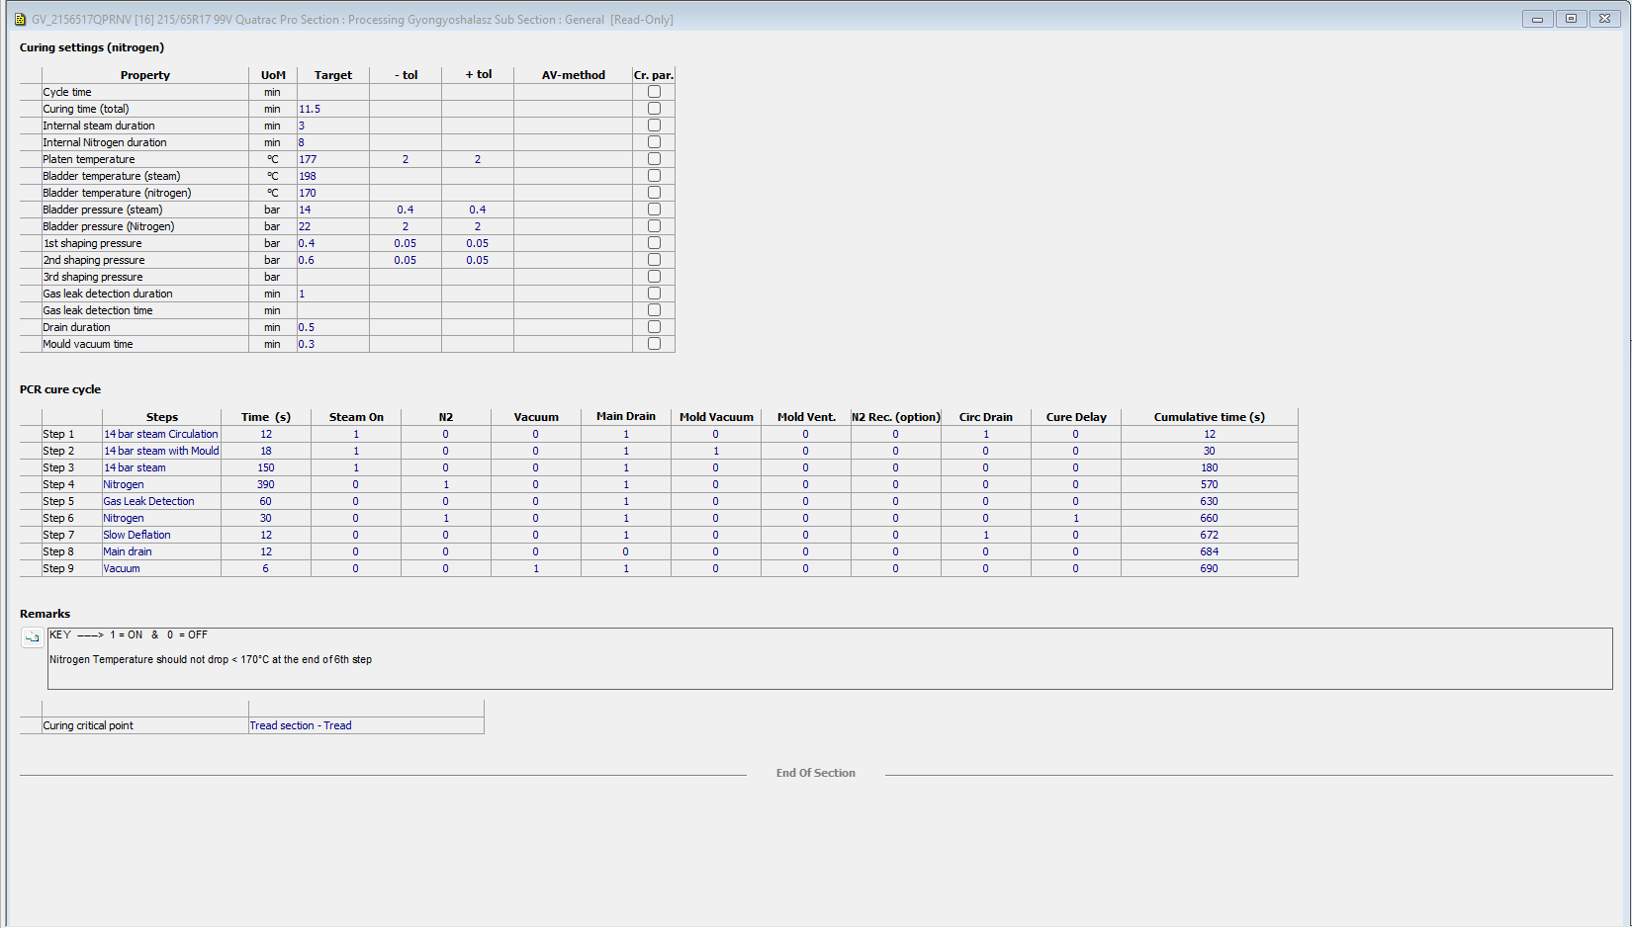

Slide 5
